Slide 1


SQL Aggregates
CS3083-B Prof. Arfaoui

Slide 2

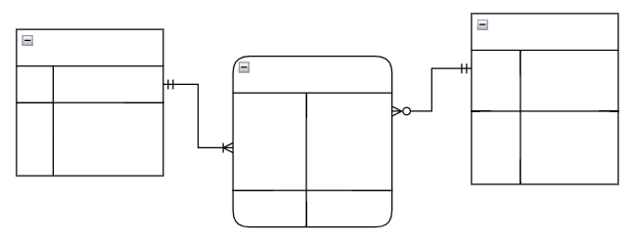


Database Design Process
Interact with stakeholders to characterize the data (requirement specification)
Translate requirements into
conceptual model (E-R diagrams)
Convert the model to relational model
(schema and constraints)
Normalize and develop
conceptual (logical) schema of the database
Implement physical schema
(SQL clauses, partitioning and indexing)

Slide 3
LAST Time:
Overview of The SQL Query Language
Parts of the query language:
SQL Data Definition Language DDL
SQL Data Manipulation Language DML
SQL Data Query language DQL
Additional Basic Operations
Set Operations
[A. Silberschatz, H. F. Korth, S. Sudarshan, Database System Concepts, Ch.3]

Slide 4
TODAY - How do we effectively summarize the results? - What is the order of actions? - How do we handle "for-each" semantics? - Applying the predicates on groups vs. individuals.
More SQL
Aggregate Functions
Group by
Having
Null Values
[A. Silberschatz, H. F. Korth, S. Sudarshan, Database System Concepts, Ch.3.7 and Ch. 5.5]

Slide 5
Aggregation Functions
Calculate a value across an entire set or across groups of rows within the set
SQL uses five aggregation operators:
• SUM – produces the sum of a column with numerical values
• AVG – produces the average of a column with numerical values
• MIN – applied to a column with numerical values, produces the smallest value
• MAX – applied to a column with numerical values, produces the largest value
• COUNT – produces the number of (not necessarily distinct) values in a column

Slide 6
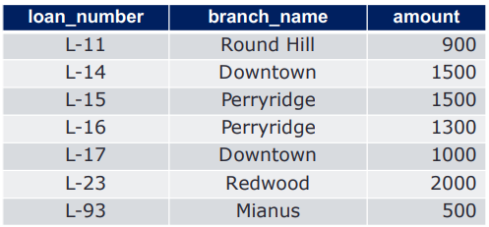
Example: SUM
Given the loan schema; loan(loan_number, branch_name, amount)
The sum of the amounts of all loans is expressed by
SELECT SUM(amount) FROM loan
SELECT SUM(amount) FROM loan

Slide 7

Example: avg
Given the loan schema; loan(loan_number, branch_name, amount)
The average of the amounts of all loans is expressed by:
SELECT AVG(amount)
FROM loan

Slide 8

Example: MIN
Given the loan schema; loan(loan_number, branch_name, amount)
The smallest amount of loans is expressed by:
SELECT MIN(amount)
FROM loan

Slide 9

Example: MAX
Given the loan schema; loan(loan_number, branch_name, amount)
The largest amount of loans is expressed by:
SELECT MAX(amount)
FROM loan

Slide 10


Example: COUNT
Given the loan schema; loan(loan_number, branch_name, amount)
Count the number of tuples in the loan table
SELECT COUNT(*) FROM loan
SELECT COUNT(loan_number) FROM loan
Count rows
Count values of a specified column

Slide 11


Example: COUNT..DISTINCT
Given the loan schema; loan(loan_number, branch_name, amount)
Count the number of values in the branch_name column
SELECT COUNT(branch_name)
FROM loan
SELECT COUNT(DISTINCT branch_name)
FROM loan

Slide 12
Aggregation: Order of Actions
SELECT select_list
FROM table_source
[WHERE search_condition]
[GROUP BY group_by_expression]
[HAVING search_condition]
[ORDER BY order_expression [ASC | DESC] ]
Order matter
1. The FROM clause generates the data set
2. The WHERE clause filters the data set generated by the FROM clause
3. The GROUP BY clause aggregates the data set that was filtered by the WHERE clause
(note: GROUP BY does not sort the result set)
4. The HAVING clause filters the data set that was aggregated by the GROUP BY clause
5. The SELECT clause transforms the filtered aggregated data set
6. The ORDER BY clause sorts the transformed data set

Slide 13


Grouping Requirement
Most DBMSs require that the columns appearing in the SELECT clause that are not used in an aggregation function must appear in the GROUP BY clause.
SELECT column_A, column_B, some_aggregation_func
FROM table_source
GROUP BY column_A, column_B
SELECT column_A, column_B, some_aggregation_func
FROM table_source
GROUP BY column_B

Slide 14
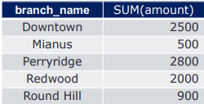
Example: SUM with GROUP BY
Given the loan schema; loan(loan_number, branch_name, amount)
The sum of the amounts of all loans for each branch is expressed by:
SELECT branch_name, SUM(amount)
FROM loan
GROUP BY branch_name;

Slide 15

Let’s Try
Open your MySQL terminal (use phpMyAdmin or MySQL shell)
Create and Select the bank DB:
Create a DB:
Use the DB:
CREATE DATABASE bank
USE bank

Slide 16
Let’s Try
Create account table:
Create loan table:
CREATE TABLE account(
account_number varchar(11) NOT NULL DEFAULT '',
branch_name varchar(20) DEFAULT NULL,
balance float DEFAULT NULL,
PRIMARY KEY (account_number)
);
CREATE TABLE loan (
loan_number varchar(11) NOT NULL DEFAULT '',
branch_name varchar(20) DEFAULT NULL,
amount float DEFAULT NULL,
PRIMARY KEY (loan_number)
) ;

Slide 17
Let’s Try (cont.)
Insert records into account table:
INSERT INTO account (account_number, branch_name, balance) VALUES
('A-101', 'Downtown', 500),
('A-102', 'Perryridge', 400),
('A-201', 'Brighton', 900),
('A-215', 'Mianus', 700),
('A-217', 'Brighton', 750),
('A-222', 'Redwood', 700),
('A-305', 'Round Hill', 350),
('A-408', 'Perryridge', 1450),
('A-900', NULL, 1250),
('A-999', NULL, 2110);

Slide 18
Let’s Try (cont.)
Insert records into loan table:
INSERT INTO loan (loan_number, branch_name, amount) VALUES
('L-11', 'Round Hill', 900),
('L-14', 'Downtown', 1500),
('L-15', 'Perryridge', 1500),
('L-16', 'Perryridge', 1300),
('L-17', 'Downtown', 1000),
('L-23', 'Redwood', 2000),
('L-93', 'Mianus', 500);`

Slide 19
Let’s Try (cont.)
Consider the table: account
Write SQL statement to solve the following problems
Count how many accounts are there.
Use COUNT(*) and COUNT(branch_name)
Find the total balance each branch has in accounts.
Find the average amount each branch has in accounts.
Consider the table: loan
Write SQL statement to solve the following problems:
Find the sum of the amounts of all loans for each branch.
Find the sum of the amounts of all loans for each branch that has two or more loans.

Slide 20
Grouping, Aggregation, and Null
The value NULL is ignored in any aggregation
Not contribute to a sum, average, or count of an attribute
Cannot be the minimum or maximum in its column
Null is treated as an ordinary value when forming groups
• Can have a group with NULL attribute(s)
When performing any aggregation except count over an empty bag of values, the result is NULL
The count of an empty bag is 0

Slide 21

HAVING Clauses
An aggregation in a HAVING clause applies only to the tuples of the group being tested – filter groups
Any attributes of relations in the FROM clause may be aggregated in the HAVING clause
But only those attributes that are in the GROUP BY list may appear unaggregated in the having clause
Find the sum of the amounts of all loans for each branch that has two or more loans.
SELECT branch_name, sum(amount)
FROM loan
GROUP BY branch_name
HAVING COUNT(branch_name) > 1;

Slide 22
Let’s Try
Create customer table:
Insert records into customer table:
CREATE TABLE customer (
customer_name varchar(30) NOT NULL DEFAULT '',
customer_street varchar(30) DEFAULT NULL,
customer_city varchar(20) DEFAULT NULL,
PRIMARY KEY (customer_name)
);
INSERT INTO customer (customer_name, customer_street, customer_city) VALUES
('Adams', 'Spring', 'Pittsfield'),
('Brooks', 'Senator', 'Brooklyn'),
('Curry', 'North', 'Rye'),
('Glenn', 'Sand Hill', 'Woodside'),
('Green', 'Walnut', 'Stamford'),
('Hayes', 'Main', 'Harrison'),
('Johnson', 'Alma', 'Palo Alto'),
('Jones', 'Main', 'Harrison'),
('Lindsay', 'Park', 'Pittsfield'),
('Smith', 'North', 'Rye'),
('Turner', 'Putnam', 'Stamford'),
('Williams', 'Nassau', 'Princeton');

Slide 23
Let’s Try (cont.)
Consider the table: customer
Write SQL statement to solve the following problems
List the number of customers in each country. Only include countries with more than 10 customers
List the number of customers in each country, except USA, sorted high to low. Only include countries with 9 or more customers

Slide 24


Solution
SELECT count(id), country
FROM Customer
GROUP BY country
HAVING COUNT(id) > 10;
SELECT COUNT(id), country
FROM Customer
WHERE country <> “USA”
GROUP BY country
HAVING COUNT(id) >= 9
ORDER BY COUNT(id) DESC;

Slide 25
Next Time .
What if we need data from multiple tables?
How do we describe a relationship between tables?
How do we realize combinations of data?
Multiple table queries
SQL Joins
Subqueries
[A. Silberschatz, H. F. Korth, S. Sudarshan, Database System Concepts, Ch.4.1]

